Slide 1


Pratik Kumar
22/05/2023

Slide 2

Outline
Executive Summary
Introduction
Methodology
Results
Conclusion
Appendix

Slide 3
Executive Summary
Summary of methodologies
Data Collection
Data Wrangling
EDA with SQL
EDA with Data Visualization
Visual Analytics with Folium
Building an Interactive Dashboard with Plotly Dash
Predictive Analysis of the Model
Summary of all results
Summary of EDA
Interactive Analysis in screenshots
Predictive Analysis result from Machine Learning Lab

Slide 4
Introduction
SpaceX is a company who has revolutionize the space industry. It offers Falcon 9 rocket launches at a cost of 62 million dollars, while others cost around 165 million dollars. SpaceX cut its cost by reusing the first stage of the launch by re-landing the rocket, which is then to be used for the next mission.
As a Data Scientist of a startup rivaling SpaceX, the aim of this project is to create the machine learning model to predict if the first stage of the SpaceX Falcon 9 rocket will land successfully. This project is crucial to identify the right price to bid against SpaceX for a rocket launch.
The problems included are as follows:
Identifying factors affecting the landing outcome.
The relationship between each factors and how it is affecting the outcome.
Identifying the suitable condition to increase the probability of a successful landing.

Slide 5

Section 1

Slide 6
Methodology
Executive Summary
Data collection methodology:
SpaceX REST API
Web Scrapping from Wikipedia
Perform data wrangling
Data was processed using one-hot encoding for categorical features
Perform exploratory data analysis (EDA) using visualization and SQL
Perform interactive visual analytics using Folium and Plotly Dash
Perform predictive analysis using classification models
Logistic Regression, KNN, SVM, and Decision Tree models have been built for prediction.

Slide 7
Data Collection
The data was collected by using REST API and Web Scrapping from Wikipedia.
The data about rocket launches was collected by SpaceX REST API using the GET request. Then, the JSON response was converted to pandas dataframe and processed further.
For Web Scrapping, BeautifulSoup was used to extract the launch records as HTML tables, which was then converted to pandas dataframe.

Slide 8
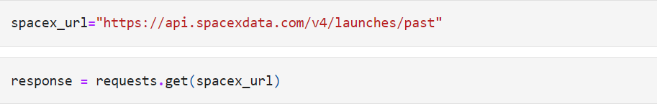
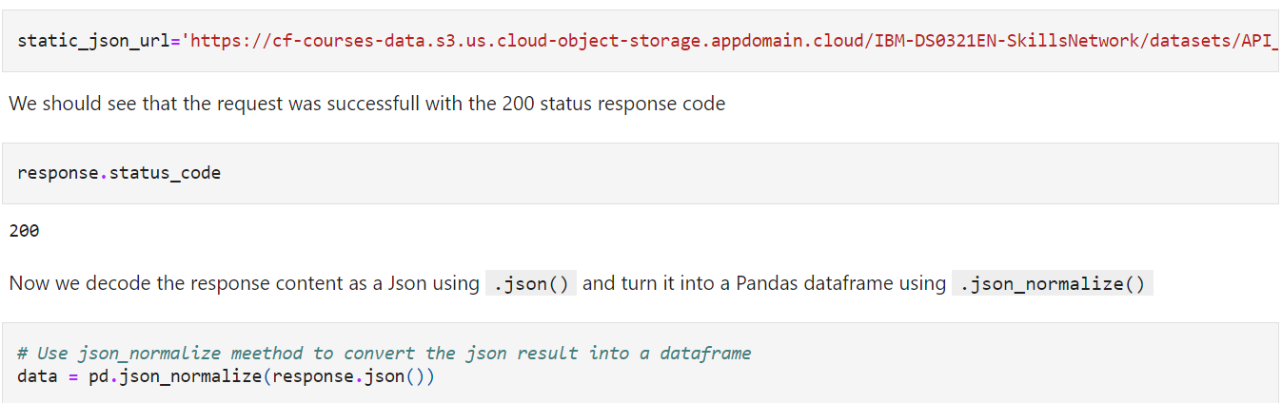
Data Collection – SpaceX API
Get Request for rocket launch from
SpaceX REST API
API returns data in JSON
Normalise data into dataframe (csv files) for filtration
GitHub URL: Data Collection API

Slide 9
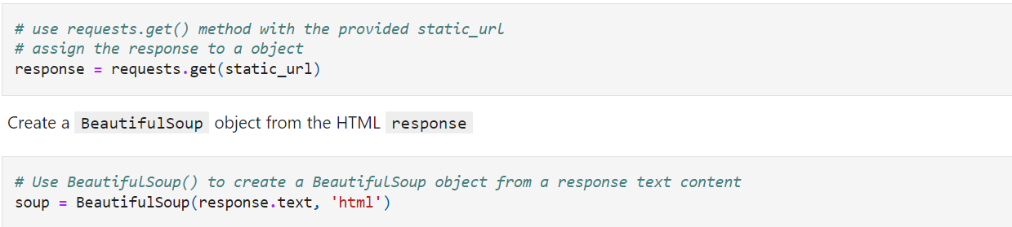
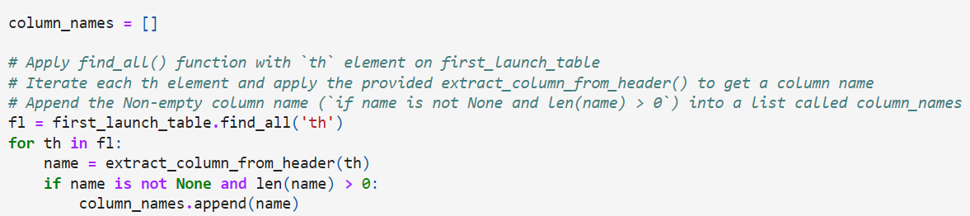
Data Collection - Scraping
Get HTML Response from
Wikipedia
Extract data using BeautifulSoup
Normalise data into dataframe (csv files) for filtration
GitHub URL: Data Collection Scrapping

Slide 10
Data Wrangling
Data Wrangling is the process of cleaning and unifying complex dataset for easy access and Exploratory Data Analysis (EDA).
GitHub Link: Data Wrangling
Calculate the number of launches on each site
Calculate the number of occurrence of each orbit
Calculate the occurrence of mission outcome per orbit type
Create a landing outcome label from outcome column
Export the result to CSV
Handling Null Values

Slide 11
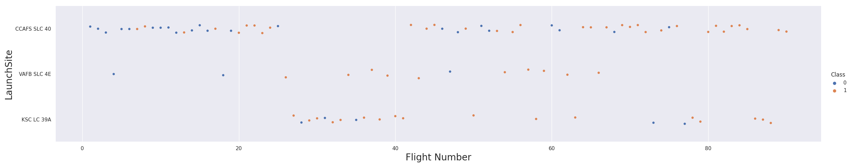
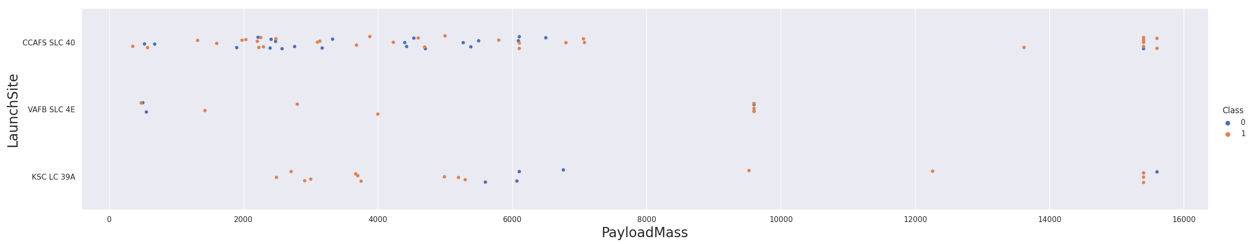
EDA with Data Visualization
Scatter Graph was used to find the relationship between the attributes such as:
Payload and Flight Number
Flight Number and Launch Site
Payload and Launch Site
Flight Number and Orbit Type
Payload and Orbit Type
GitHub URL: Data Visualization

Slide 12
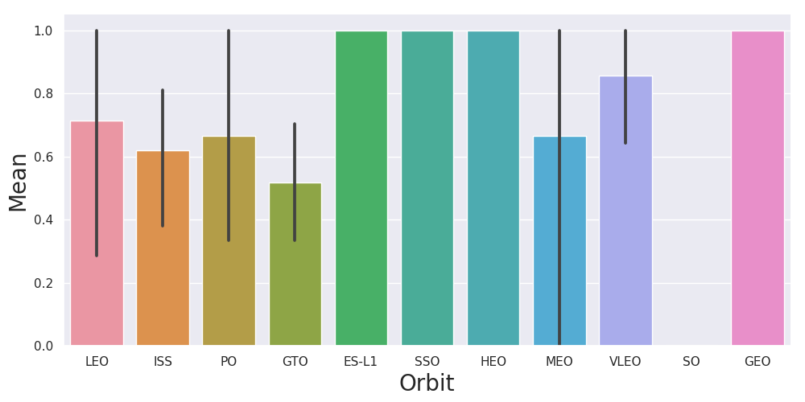
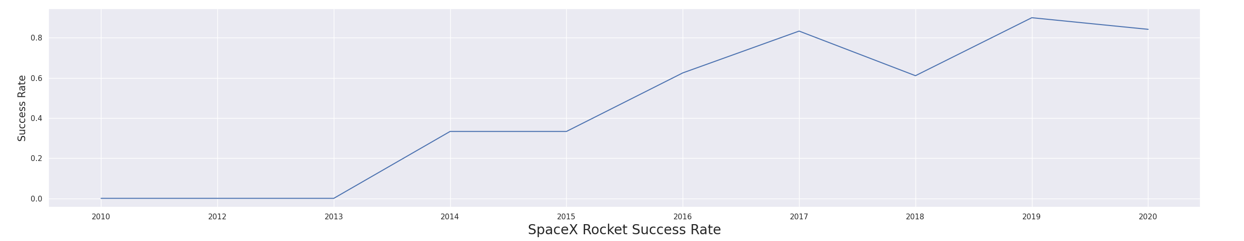
EDA with Data Visualization
Further visualization tools such as Bar Graph and Line Plots were used for further analysis.
Bar Graph was used to determine which orbits have the highest probability of success.
Line Graph was used to show yearly trend of launch success.
Then, feature engineering was used by creating dummy variables to categorical columns.
GitHub URL: Data Visualization

Slide 13
EDA with SQL
Different SQL queries are performed to get a better understanding of the dataset:
Display the names of the launch sites
Display 5 records where launch sites begin with the string ‘CCA’
Display total payload mass carried by booster launched by NASA (CRS).
Display the total payload mass carried by booster version F9 v1.1.
The date when the first successful landing outcome in ground pad was achieved.
Names of the boosters which have success in drone ship and have payload mass greater than 4000 but less than 6000
List the total number of successful and failure mission outcomes
List the names of the booster versions which have carried the maximum payload mass
List the records which will display the month names, failure landing outcomes in drone ship ,booster versions, launch site for the months in year 2015
Rank the count of successful landing outcomes between the date 04-06-2010 and 20-03-2017 in descending order
GitHub URL: EDA with SQL

Slide 14
Build an Interactive Map with Folium
An interactive map was used to visualize the launch data using Folium. The coordinates are considered there, and a circle marker was used around each launch sites.
The Launch Outcomes (Failure, Success) were assigned to 0 and 1 with Red and Green markers on the map.
Then, the distance of the launch sites from various landmarks are calculated for further observations such as:
The distance of launch sites from railways, highways, ports, etc.
The distance of launch sites from different cities.
GitHub URL: Interactive Map

Slide 15
Build a Dashboard with Plotly Dash
An interactive dashboard with Plotly dash was created to allow users to visualize the data as per their needs.
Pie Charts were plotted which show the total launches by a launch site.
Scatter Graphs were plotted showing the relationship between Outcome and Payload Mass for different booster versions.
GitHub URL: Plotly Dash

Slide 16
Predictive Analysis (Classification)
Feature Engineering
Load the dataset
Transformation and Splitting of data
Building the Model
Fitting Data into different ML models
Getting suitable Hyperparameter
Model Evaluation
Checking the accuracy for each model
Plotting the Confusion Matrix for models
GitHub URL: Predictive Analysis

Slide 17
Results
Some of the results that can be concluded from different analysis are as follows:
Logistic Regression, SVC, and Decision Tree are the best algorithms for prediction in terms of accuracy.
The success rate of SpaceX launches is directly proportional to the time in years they will finally perform the launches.
Low weighted payloads perform better than heavy payloads during the launch.
KSC LC 39A has the most successful launches across all the launching sites.
Orbit GEO, HEO, SSO, ES L1 has the best success rate among all.

Slide 18

Section 2

Slide 19
Flight Number vs. Launch Site
The scatter plot of Flight Number vs. Launch Site shows that the larger the flights amount of the launch site, the success rate will be greater. However, CCAFS SLC40 shows the least pattern.

Slide 20
Payload vs. Launch Site
The scatter plot of Payload vs. Launch Site doesn’t show any evident pattern. However, success rate goes higher if the payload mass is greater than 7000 kgs.

Slide 21
Success Rate vs. Orbit Type
ES-L1, SSO, HEO, and GEO have 100% success rate throughout the launches. However, some of these orbits have only one launch data recorded, which makes it difficult to conclude.

Slide 22
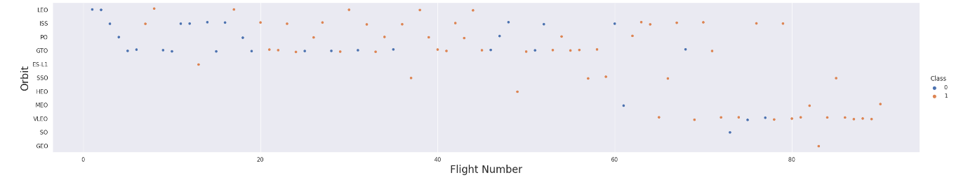
Flight Number vs. Orbit Type
The scatter plot shows that the larger the flight number on each orbit, the greater its success rate will be. However, GTO doesn’t follow this tread, and orbits having only 1 occurrence should be excluded from the statement.

Slide 23
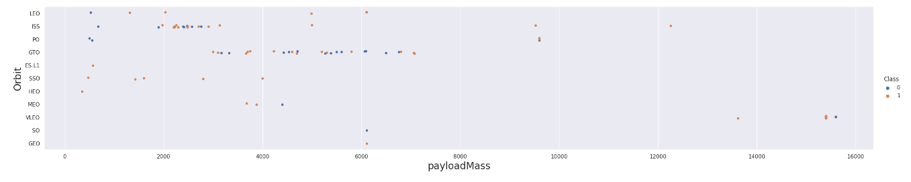
Payload vs. Orbit Type
Heavier payload shows positive trend in case of LEO, ISS, and PO orbit. However, it has negative impact on MEO and VLEO orbit.

Slide 24
Launch Success Yearly Trend
The trend shows that success rate is increasing from the year 2013 until 2020.

Slide 25
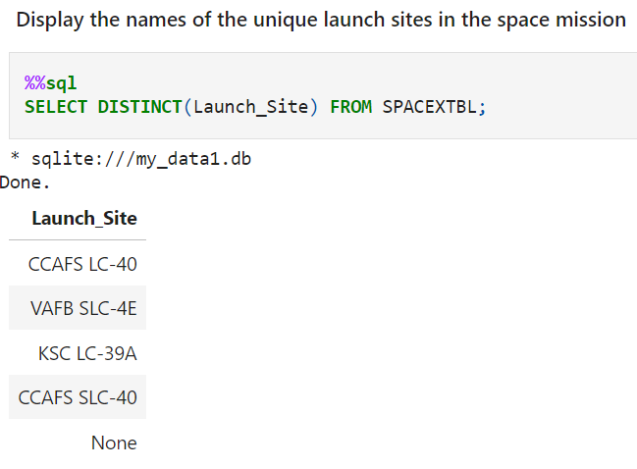
All Launch Site Names
DISTINCT keyword was used to show unique launch sites from the SpaceX database.

Slide 26
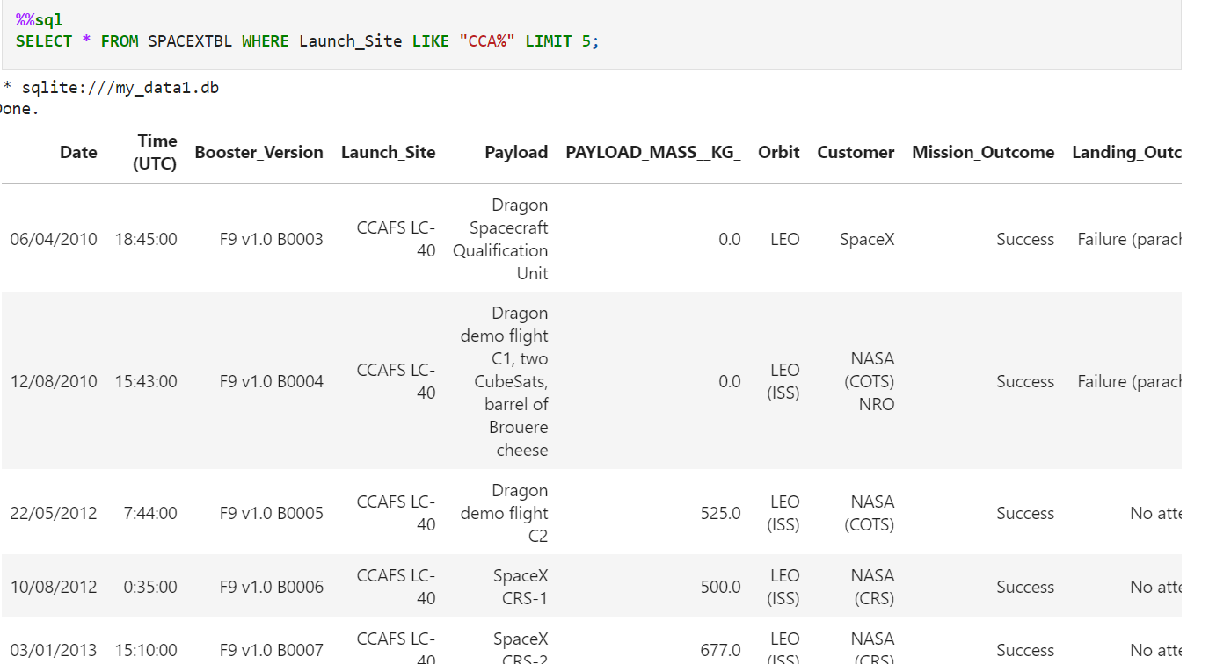
Launch Site Names Begin with 'CCA'
The query below shows the Launch Sites whose name starts with ‘CCA’.

Slide 27
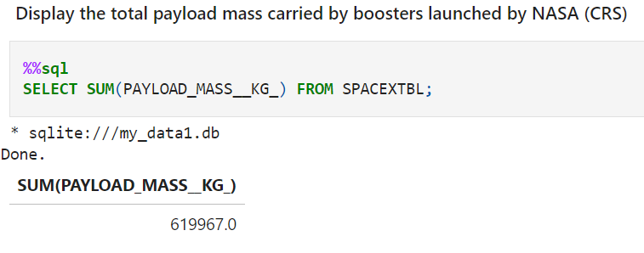
Total Payload Mass
Total Payload Mass was calculated using the query below.

Slide 28
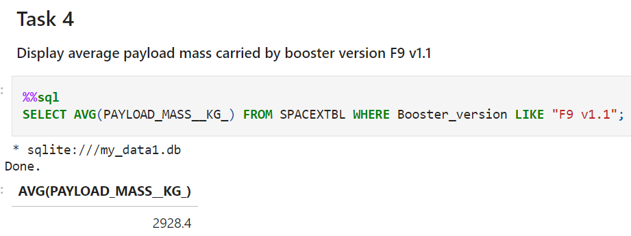
Average Payload Mass by F9 v1.1
Average payload mass carried by booster version F9 v1.1 was calculated using AVG keyword.

Slide 29
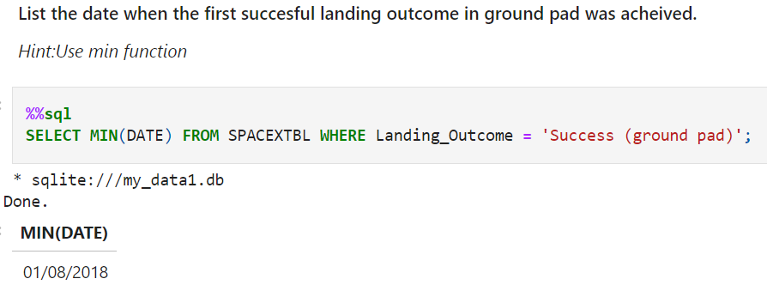
First Successful Ground Landing Date
The first successful landing date was found for the SpaceX Launch Mission using the query given below.

Slide 30
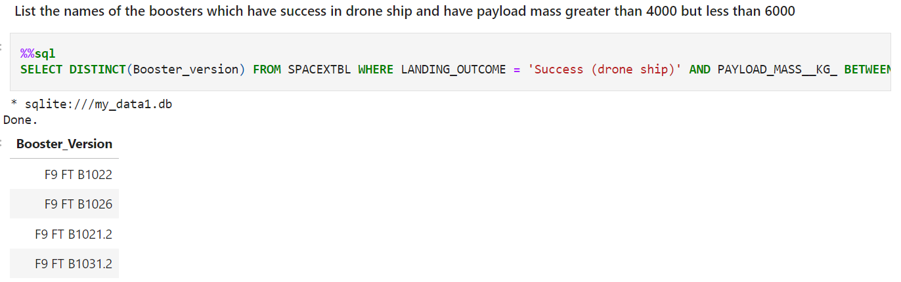
Successful Drone Ship Landing with Payload between 4000 and 6000
The query below shows the names of boosters which have successfully landed on drone ship and had payload mass greater than 4000 but less than 6000.

Slide 31
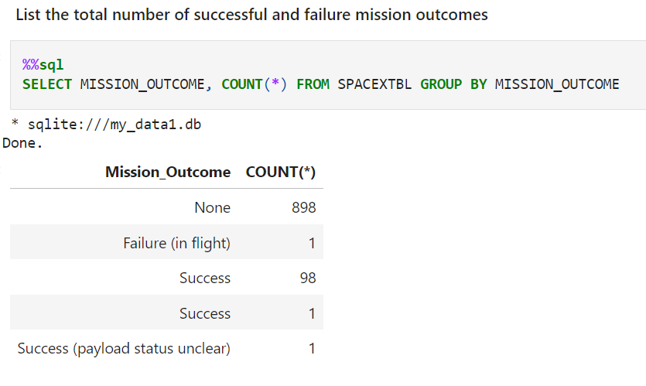
Total Number of Successful and Failure Mission Outcomes
Total number of successful and failure mission outcomes was found using the query below. There are a total of 100 successful missions and 1 unsuccessful mission.

Slide 32
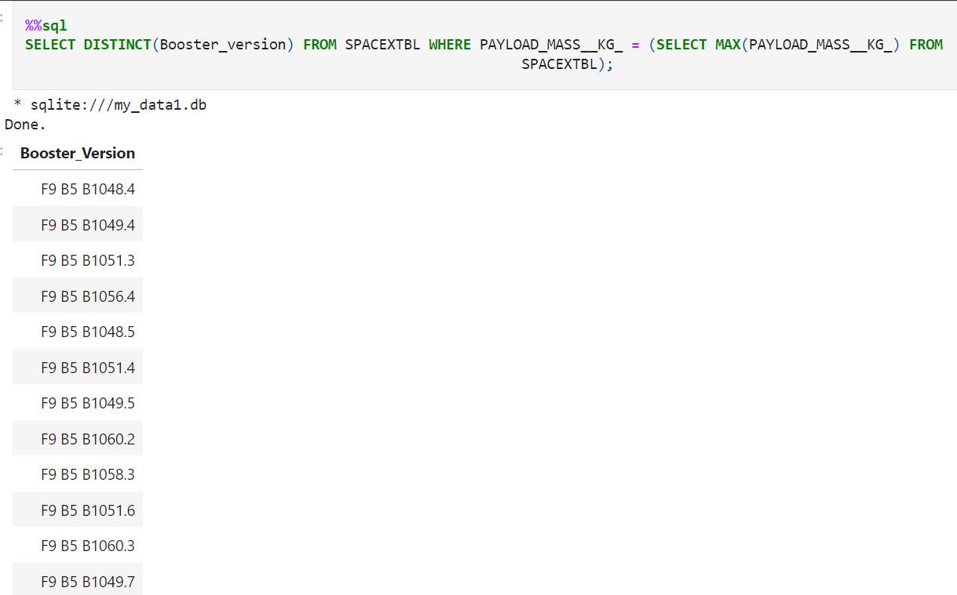
Boosters Carried Maximum Payload
The below query shows the names of the booster which have carried the maximum payload mass.

Slide 33
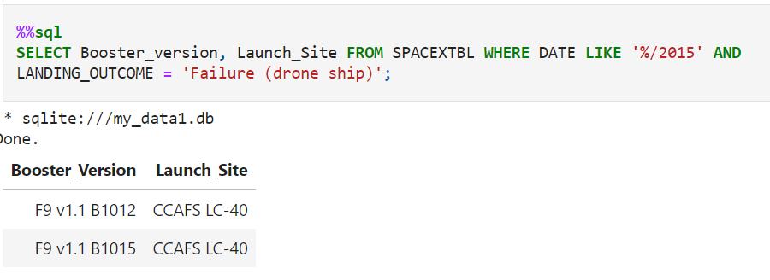
2015 Launch Records
The below query shows the failed landing outcomes in drone ship, their booster versions, and launch site names from 2015 launch records.

Slide 34
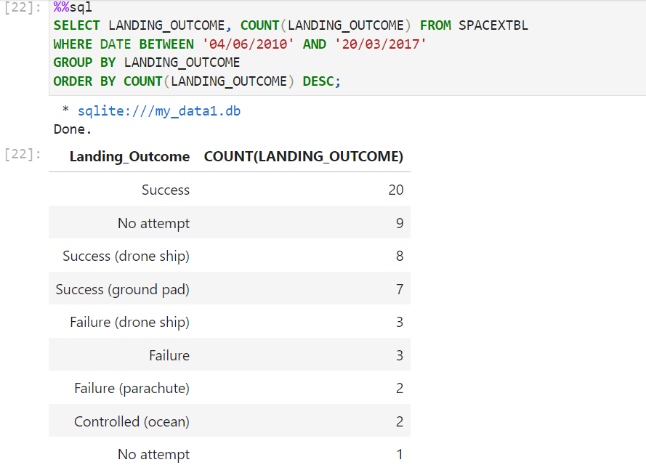
Rank Landing Outcomes Between 2010-06-04 and 2017-03-20
The below query shows the rank the count of landing outcomes between the date 2010-06-04 and 2017-03-20, in descending order.

Slide 35

Section 3

Slide 36
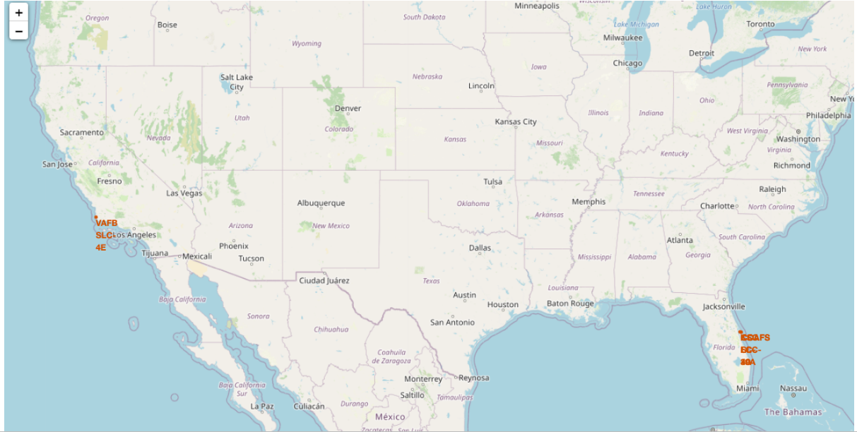
Location of the Launch Sites
From the Folium map, we can see that all the launch sites of SpaceX are in The United States.

Slide 37
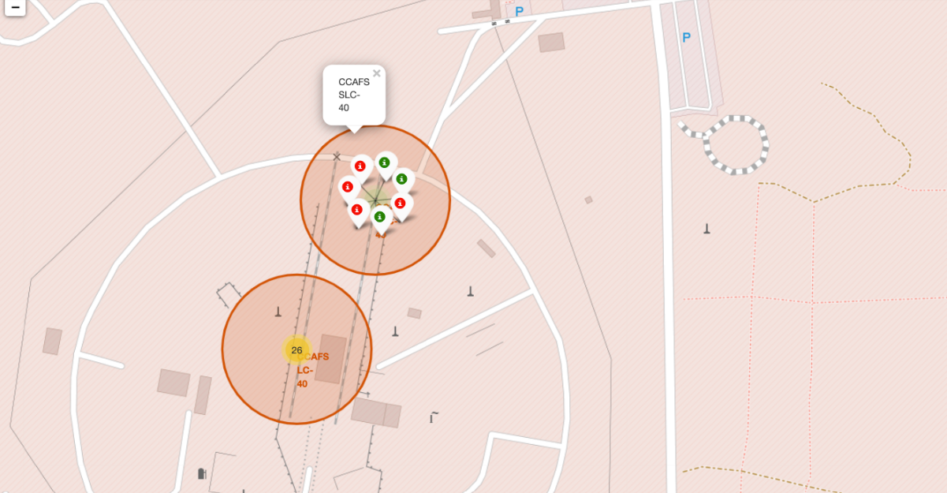
Color Label Markers
The map shows the color-labeled launch outcomes on a launch site.

Slide 38
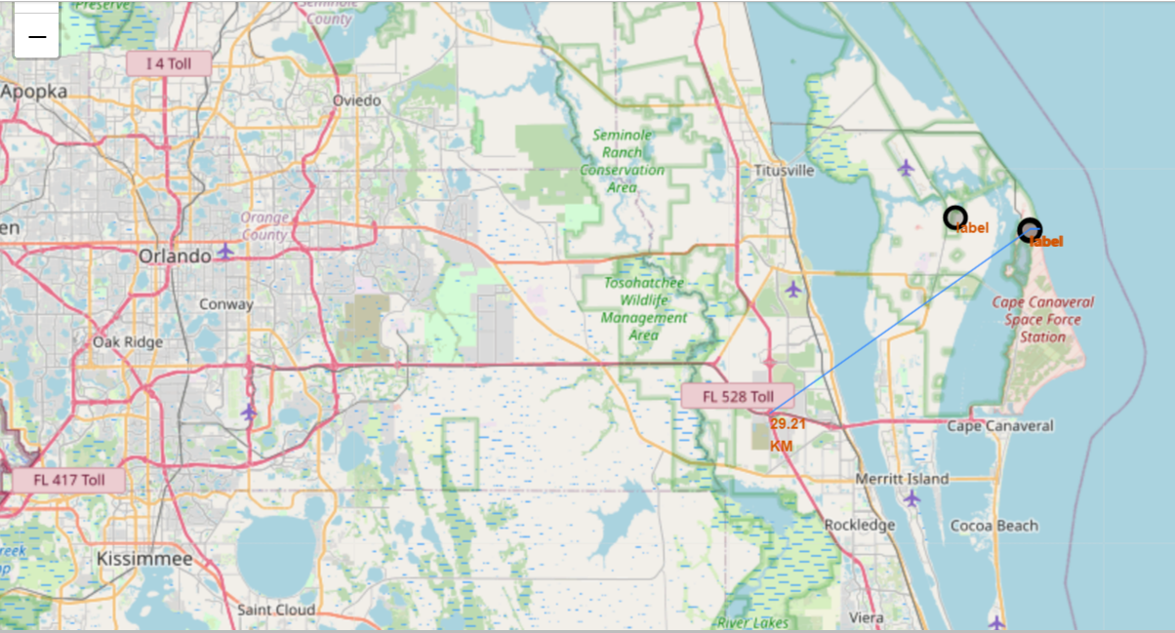
Launch Site Distance to Landmarks
The map shows the distance of Launch Site from landmarks.

Slide 39

Section 4

Slide 40
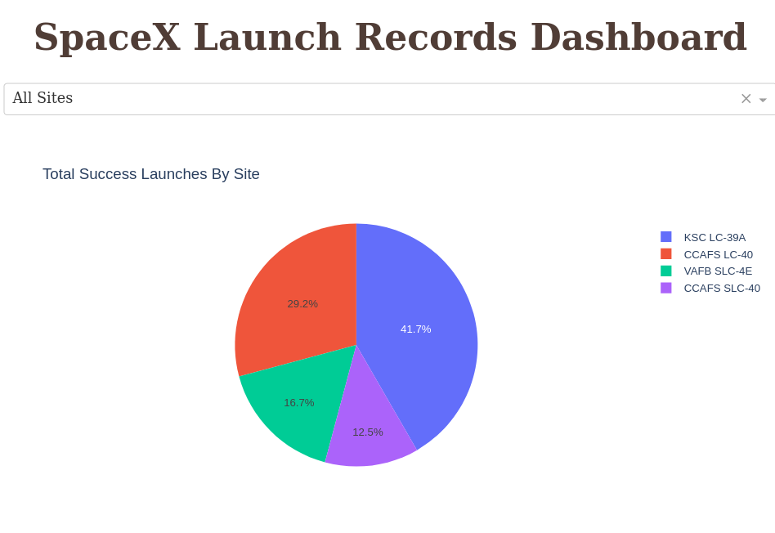
Success Percentage for each Launch Site
KSC LC-39A has the highest success percentage among all the launch sites.

Slide 41
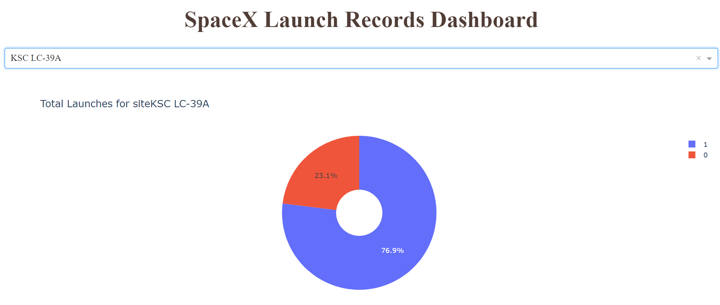
Highest Launch Success Ratio

Slide 42
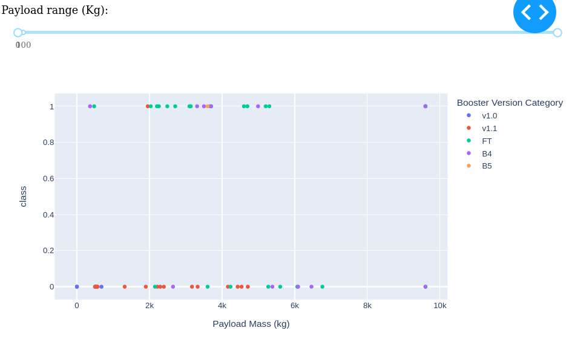
Payload vs Launch Outcome Scatter Plot
The scatter plot shows the relation between payload mass and the launch outcome. The slider can be used to set the range of payload mass.

Slide 43

Section 5

Slide 44
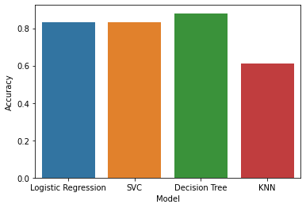
Classification Accuracy
According to the Bar Graph, it can be seen that Decision Tree has the best accuracy score among the other models.

Slide 45
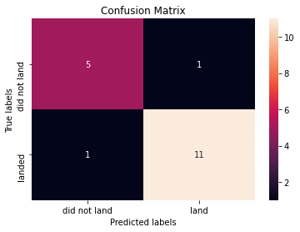
Confusion Matrix
The picture shows the confusion matrix for Decision Tree model, which shows that the classifier can distinguish between the different classes. However, some unsuccessful landing are marked as successful landing by the classifier.

Slide 46
Conclusions
The results that can be concluded from different analysis are as follows:
Decision Tree is the best algorithms for prediction in terms of accuracy.
The success rate of SpaceX launches is directly proportional to the time in years they will finally perform the launches.
Low weighted payloads perform better than heavy payloads during the launch.
KSC LC 39A has the most successful launches across all the launching sites.
Orbit GEO, HEO, SSO, ES L1 has the best success rate among all.

Slide 47
Appendix
Here’s the GitHub URL to the repository which contains all the files related to the project.
GitHub URL: Capstone Project

Slide 48


